Slide 1
ROBOTune, HUNTER, ONLINETUNE
연세대학교 컴퓨터과학과 권세인
2023년 9월
과제명: IoT 환경을 위한 고성능 플래시 메모리 스토리지 기반 인메모리 분산 DBMS 연구개발
과제번호: 2017-0-00477

Slide 2
INDEX
ROBOTune: High-Dimensional Configuration Tuning for Cluster-Based Data Analytics
(International Conference on Parallel Processing. 2021.)
HUNTER: An Online Cloud Database Hybrid Tuning System for Personalized Requirements
Towards Dynamic and Safe Configuration Tuning for Cloud Databases

Slide 3
CONTRIBUTION
ROBOTune (Random FOrests and Bayesian Optimization based Tune)
: Tune cluster-based data analytics applications quickly for efficient data analytics.
Challenging issues.
High-dimensionality
Complex multi-modal configuration-performance relationship faced by the configuration tuning of cluster-based data analytics applications.

Slide 4
CONTRIBUTION
ROBOTune (Random FOrests and Bayesian Optimization based Tune)
Three main techniques.
First, trains a Random Forests based model for parameter selection.
Reduces the dimensionality of the configuration space.
Next, features a Bayesian Optimization that overcomes the complex configuration performance relationship.
incrementally searches for an optimal configuration based on the observations of prior configuration samples.
Third, strengthens Latin Hypercube Sampling with caching and memoization to enhance the coverage and effectiveness
in the generation of sample configurations.

Slide 5
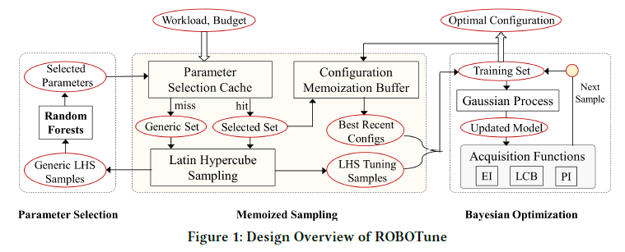
DESIGN OVERVIEW OF ROBOTune
Memoized Sampling
Latin Hypercube Sampling (LHS) to selection of samples from a high dimensional space.
Also provides a parameter selection cache and a configuration memoization buffer
to speed up tuning for repeated workloads with different inputs.

Slide 6
MEMOIZED SAMPLING
Latin Hypercube Sampling.
Needs fewer samples also more stable with fewer samples.
Dimension agnostic, meaning that the number of samples required is not tied to the dimensionality of the configuration space.
we employ LHS to generate the samples for BO initialization and parameter selection.

Slide 7
MEMOIZED SAMPLING
Parameter Selection Cache.
we store the previous selections in a table which contains a previously tuned workload and its high-impact parameters.
1) Repeated workload will incur a hit in the cache.
Directly pull a Selected Set of parameters, which form a low dimensional configuration space.
LHS will generate a total of 20 LHS Tuning Samples for the BO engine.
2) An unseen workload will incur a miss in this cache.
In that case, 100 LHS samples on the Generic Set containing the initial parameters will be generated for use by the
parameter selection component.
Notes:
Speicific한 workload에서는 dataset이 다르더라도 dbms에 큰 영향을 주는 파라미터는 같기 때문에

Slide 8
MEMOIZED SAMPLING
Configuration Memoization Buffer.
We also find that previously tuned configurations are beneficial to the BO engine when tuning the same workload with a different input.
Configuration Memoization Buffer to save a few high-performance configurations at the completion of each BO tuning session.
Pull 4 Best Recent Configs that has been tuned before + 16 LHS tuning samples.
For an unseen workload, the initial training set only contains 20 LHS tuning samples.

Slide 9
DESIGN OVERVIEW OF ROBOTune
Parameter Selection
Performs dimension reduction through Random Forests, based on samples from a high-dimensional configuration space.

Slide 10
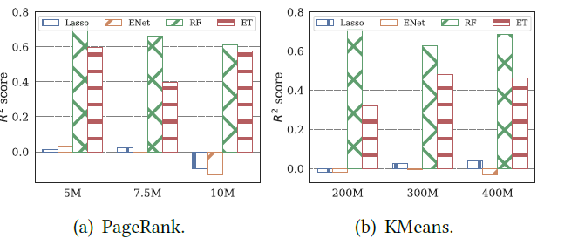
PARAMETER SELECTION
Choice of Random Forests.
Dimension reduction techniques like PCA, which create linear combinations of the original features, are not applicable.
Because we need to keep the original parameters for configuration tuning.
Random Forests (RF) is an ensemble learning method that utilizes a multitude of decision trees.
It has shown to perform better than linear models given a similar number of samples for cluster computing frameworks.
Notes:
두 개의 linear-based model과 두 개의 tree-based model
Coefficient of determination : 모델이 얼마나 잘 관찰된 결과를 추정하는지

Slide 11
PARAMETER SELECTION
Ranking the Parameters.
The conventional method of utilizing MDI can be unreliable where potential predictor variables vary in their scale of measurement or their number of categories,
We thus consider the Mean Decrease in Accuracy (MDA) method, which is a bit slower than MDI but more robust
Using this method of feature importance calculation, we identify the parameters that impact the workload performance.
Notes:
랜덤 포레스트에서의 변수 중요도
MDI(Mean Decrease in Impurity) Importance : 각 변수가 split될 때 impurity 감소분의 평균을 중요도로 정의
변수의 범주와 측정 규모가 다양한 경우에는 신뢰할 수 없음
MDA(Mean Decrease Accuracy) : 관련 변수 값을 다른 값으로 대체했을 때 정확도가 감소하는 정도

Slide 12
DESIGN OVERVIEW OF ROBOTune
Bayesian Optimization (BO)
Equips ROBOTune with a gaussian process (GP) model to estimate the objective function f (x).
And iteratively searches for the optimal configuration through a combination of three acquisition functions with balanced exploration and exploitation.

Slide 13
BAYESIAN OPTIMIZATION ENGINE
Choice of Model.
Gaussian Process (GP) Regression
It provides a theoretically justified way to trade-off exploration and exploitation.
It has been applied successfully to real-world systems.
Choice of Acquisition Function.
Probability of Improvement (PI)
: Optimizes the probability of improvement over the current best point x+.
(2) Expected Improvement (EI)
: Optimizes the expected improvement with respect to the current best value.
(3) Lower confidence bound (LCB)
: Selects points with the best confidence interval.
We adopt Hedge which constructs an adaptive portfolio of multiple acquisition functions.
At each iteration, chooses one probabilistically.
The probability of choosing an acquisition function is updated based on the cumulative rewards (gain) at each step.
Notes:
EI : 현재까지 추정된 목적 함수를 바탕으로 어느 후보 입력값 x에 대한 유용성을 나타내는 숫자
PI : 현재까지 조사된 점들의 함숫값 중 최대 함숫값보다 더 큰 함숫값을 도출할 확률

Slide 14
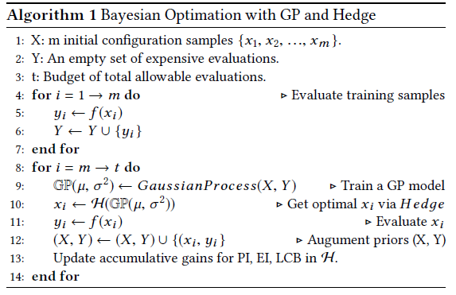
INTERGRATING GP AND HEDGE
Trains a GP model (GP) with prior observations of objective function (i.e., execution time).
Selects a new point using the Hedge-based portfolio function (H).
(3) Makes another observation of the objective function
(4) Updates the set of prior observations and accumulative gains of individual acquisition functions in Hedge.
Notes:
Global minimum 값 찾을 때까지
Benchmark – SprakBench, datasets are generated using Sparkbench

Slide 15
INDEX
ROBOTune: High-Dimensional Configuration Tuning for Cluster-Based Data Analytics
HUNTER: An Online Cloud Database Hybrid Tuning System for Personalized Requirements
(International Conference on Management of Data. 2022.)
Towards Dynamic and Safe Configuration Tuning for Cloud Databases

Slide 16
CONTRIBUTION
Facing personalized requirements such as various restrictions for tuning with very different workloads,
pre-trained models may mismatch or recommend suboptimal configurations given a new workload.
If the system tunes configurations in an online fashion, the system will suffer from the cold start problem, resulting in long tuning time and performance fluctuation.
(1) An online tuning system to improve the performance as well as efficiency and practicability on CDB.
(2) Availability problem by tuning and testing configurations on cloned CDBs.
(3) Adaptability problem by using online tuning with efficiency.
(4) Cold start problem with a hybrid architecture, in which we use the samples generated by GA to warm-up DDPG.
(5) Based on the cloned CDBs, we design a parallel scheme for DRL.
PROPOSE , SOLVE
Notes:
CDB

Slide 17
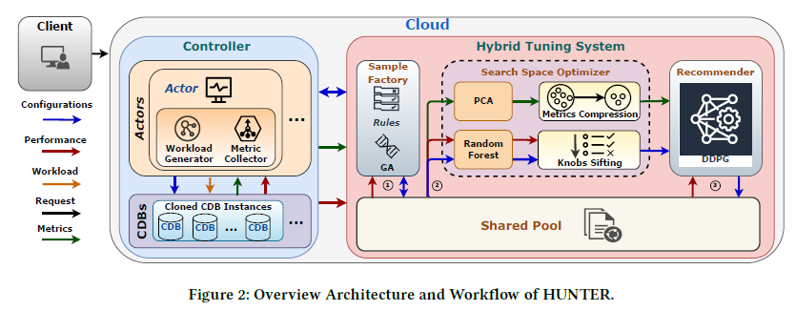
DESIGN OVERVIEW OF HUNTER
The Controller interacts with the target DBMS, tuning system, and users.
It is comprised of Actors and CDBs.
Actors are designed to collect runtime information from the DBMS
Clone the user’s instances on CDBs, and manage the parallel execution on cloned CDBs.

Slide 18
DESIGN OVERVIEW OF HUNTER
{($S_{i }$, $A_{i}$ , $P_{i})\}$
$S_{i }$: metrics
$A_{i}$ : Configuration
$P_{i}$ : Performance
Hybrid Tuning System consists of a Shared Pool of sampled configurations, interacting with three components.
Sample Factory
Generates samples according to target workloads and the user’s requirements, via GA and Rules.
Rules are restrictions defined by users or DBAs.
(b) Search Space Optimizer
Takes as input the samples generated by the Sample Factory and conduct compression and dimension reduction
over both metrics and search space.
(c) Recommender
Uses reinforcement learning to further explore the search space, warm-started using the Shared Pool of samples.

Slide 19
WORKFLOW OF HUNTER
Given request, the Controller allocates a set of Actors, each of which first clones the user’s instance.
In the first phase, each Actor generates random configurations and stress-tests them on cloned CDBs.
Each stress testing generates a sample, which is put into the Shared Pool.
Sample Factory takes as input these randomly generated samples and uses GA to generate new configurations.
The Controller then stress-tests these newly-generated configurations and produces new samples in the Shared Pool.
Notes:
Historical이 있어도 workload가 다르고 search space가 다르면 이전 지식을 전송하기 어렵다.
그래서 제안한게 사용자의 워크로드에 대해서 online exploration을 하자는 것. -> clod-start 문제가 생김
Search space를 빠르게 탐색하고 싶을 때, 적은 정보가 필요하기 때문에 세세한 탐색은 못하지만 짧은 시간 안에 sampl을 develop 하고 싶을 때 , 성능이 별로 안좋음

Slide 20
WORKFLOW OF HUNTER
In the second phase, the Search Space Optimizer collects statistics using all samples in the Shared Pool,
and conducts compression and sifting over metrics and knobs.
In the third phase, Recommender acts over samples with reduced dimension and generates new configurations.
Newly-generated configurations are tested by the Controller until the total wall clock time reaches a total time budget.
The Controller then deploys configurations with the best performance on the user’s instance.
Notes:
그래서 바꾼게 DDPG - 세세한 탐색, GA를 통해 수집된 sampl을 사용해서 warm-start를 한다.

Slide 21
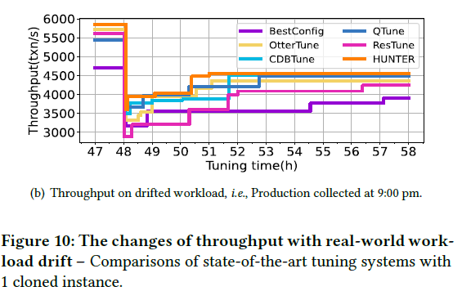
FUTURE WORK
Workload Drift and Historical Data Reuse.
Keeping tuning knobs during the life of instance, we simplify this issue to whether the tuner can learn from historical data to recommend knobs with high performance in a short time before the workload drift occurs again.
Notes:
Drift가 일어나도 튜닝을 계속 진행해야할까?

Slide 22
FUTURE WORK
Sensitive Queries
Tuning may improve most queries but regress some sensitive ones.
In addition, tuning knobs is a multi-objective optimization problem, considering both the latency of sensitive queries and the overall performance.
Warm-up Database
Generally, the large the data set is, the longer the warm-up time will be.
Warm-up DRL Model and Representative workload
Make DRL models converge faster without losing the optimal solution
Replacing the DRL model or optimizing the fetch of samples.
We choose data augmentation technology to improve the quality of samples.
Find an effective scheme to warm up the DRL model, as the reasons for GA's ability to collect high-quality samples remain obscure.
Notes:
샘플 사용하는 것을 최적화 하기
샘플의 품질을 향상시키기위해 데이터 양을 늘림 (GA), DRL 모델의 수렴이 가속화될 것으로 기대.
65 knobs, 64 metrics
시스벤치 – Sysbench RO, WO RW TPC-C real-world workload
벤치마크 – standard benchmark
MySQL (v5.7), PostgreSQL (v12.4)

Slide 23
INDEX
ROBOTune: High-Dimensional Configuration Tuning for Cluster-Based Data Analytics
HUNTER: An Online Cloud Database Hybrid Tuning System for Personalized Requirements
Towards Dynamic and Safe Configuration Tuning for Cloud Databases
(arXiv 2022)

Slide 24
CONTRIBUTION
There are still gaps to apply the existing systems in production environments, especially in the cloud.
Online database tuning should fulfill ~
Dynamicity: The tuner is capable of responding to the dynamic environment adaptively.
Safety: The tuner should recommend configurations that do not downgrade the database performance during
the tuning process.
We propose a context featurization model that extracts features of workloads and underlying data.
Using this, OnlineTune adopts the contextual Bayesian optimization technique to optimize the database adaptively with constantly changing environments.
To enhance the scalability of OnlineTune with extensive data in the cloud, we propose a clustering and model selection strategy that significantly decreases the computation complexity.
To solve the safety issue, we combine the black-box and the white-box knowledge to evaluate the safety of configurations and propose a safe exploration strategy via subspace adaptation,
Notes:
(e.g., workload and its underlying data)
Dynamic env에도 적응할 수 있어야, tuning 과정에서 디비 성능을 저하시키지 않으면서 놉추천

Slide 25
DESIGN OVERVIEW OF ONLINETUNE
The safety threshold is set to the default performance.
Contextual performance modeling
Aims at obtaining a surrogate model that predicts the performance of given configurations in dynamic environments.
The surrogate is a contextual Gaussian Process (GP) model fitted on historical observations
OnlineTune first captures the dynamic factors through context featurization, obtaining a context.
It then selects a contextual GP model fitted on the observations from the cluster with similar contexts.
The clusters are periodically re-clustered in an online manner.
The construction of contextual GP.
Notes:
(or the initial safety set, if no historical observations exist).

Slide 26
DESIGN OVERVIEW OF ONLINETUNE
Safe configuration recommendation aims at selecting a safe and promising configuration from the configuration space.
For a newly fitted model, OnlineTune initializes a subspace centered around the best-estimated configuration.
Otherwise, OnlineTune adapts the subspace according to the tuning history.
The adapted subspace is discretized to build a candidate set.
OnlineTune assesses the safety of the candidates based on the model’s lower bound estimate, forming a safety set.
It also consults the white box to dismiss unsafe configurations.
OnlineTune then selects a configuration from the safety set by either maximizing the acquisition function or exploring the safe boundaries of subspace.
Finally, OnlineTune applies the configuration to the online database and evaluates its performance.
Notes:
가장 잘 예측된 config를 중심으로 subspace를 초기화

